Slide 1
USE – CASE MODELING

Slide 2

Key Ideas
Use cases are a text-based method of describing and documenting complex processes
Use cases add detail to the requirements outlined in the requirement definition
Systems analysts work with users to develop use cases
Systems analysts develop process and data models later based on the use cases

Slide 3
Roles of Use Cases
A use case is a set of activities that produce some output result
Describes how the system reacts to an event that triggers the system
Trigger -- event that causes the use case to be executed
Event-driven modeling – everything in the system is a response to some triggering event

Slide 4

Modeling Use Cases
Complete piece of functionality
  Main flow/Main success scenario
  Subflows
  Exensions/Alternate flows

Slide 5
Role of Use Cases
All possible responses to the event are documented
Use cases are helpful when the situation is complicated

Slide 6
Sample Format for a
Written Use Case
Title – descriptive name, matches name in use case diagram
Primary actor – usually a user role
Stakeholders – any group or individual with an interest in the function of the use case
Precondition – conditions that must be satisfied in order to execute the use case

Slide 7
Sample Format for a
Written Use Case - 2
Minimal guarantee/Postcondition – outputs that can be expected if the service attempt failed
Success guarantee/Postcondition – outputs that can be expected if the service succeeds
Trigger – an event or action that initiates the use case
Main success scenario – description of sequence of interactions between actor and use case during the use case execution
Extensions – detailed description of how errors are dealt with

Slide 8
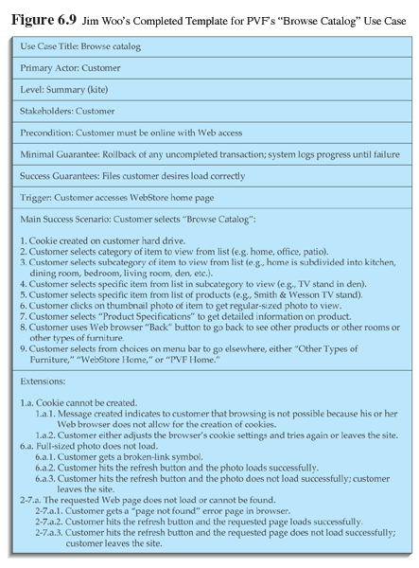
A sample written use case

Slide 9
Building Use Cases

Slide 10
Step 1:
Identify the major use cases
Activities | Typical Questions Asked
Start a use case form for each use case If more than nine, group into packages | Ask who, what, and where about the tasks and their inputs and outputs: What are the major tasks performed? What triggers this task? What tells you to perform this task? What information/forms/reports do you need to perform this task? Who gives you these information/forms/reports? What information/forms/reports does this produce and where do they go?

Slide 11
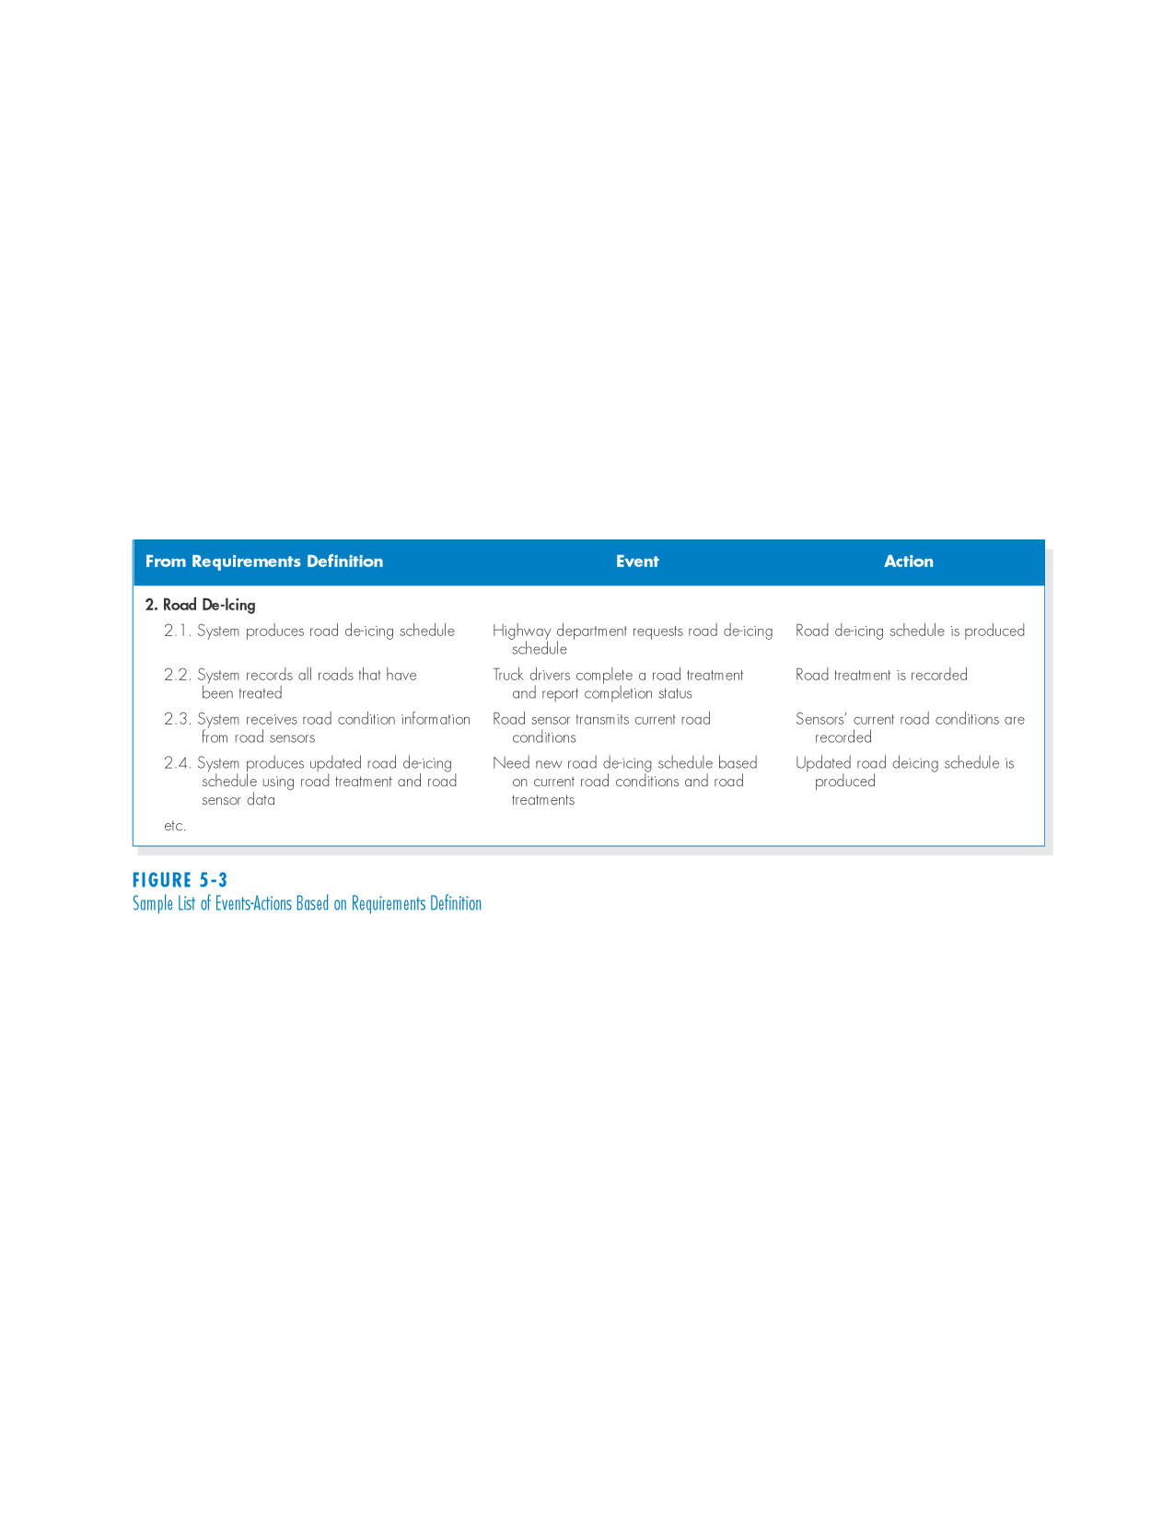
Sample List of Events-Actions Based on Requirements Definition

Slide 12
Step 2: Identify the major steps within each use case
Activities | Typical Questions Asked
For each use case, fill in the major steps needed to process the inputs and produce the outputs | Ask how about each use case: How do you produce this report? How do you change the information on the report? How do you process forms? What tools do you use to do this step (e.g., on paper, by email, by phone)?

Slide 13
Step 3:
Identify elements within steps
Activities | Typical Questions Asked
For each step, identify its triggers and its inputs and outputs | Ask how about each step How does the person know when to perform this step? What forms/reports/data does this step produce? What forms/reports/data does this step need? What happens when this form/report/data is not available?

Slide 14
Step 4:
Confirm the use case
Activities | Typical Questions Asked
For each use case, validate that it is correct and complete | Ask the user to execute the process using the written steps in the use case – that is, have the user role-play the use case

Slide 15
Interim Summary
Use cases contain all the information needed for process modeling, but are easier for users to comprehend
Use cases are created in an iterative cycle of steps until they are considered accurate and complete

Slide 16
Exercise: Use Cases
Describe one major use case from your team project (try to find the most important one) using the template provided (based on Fig. 6-4 on pg. 174).

Slide 17
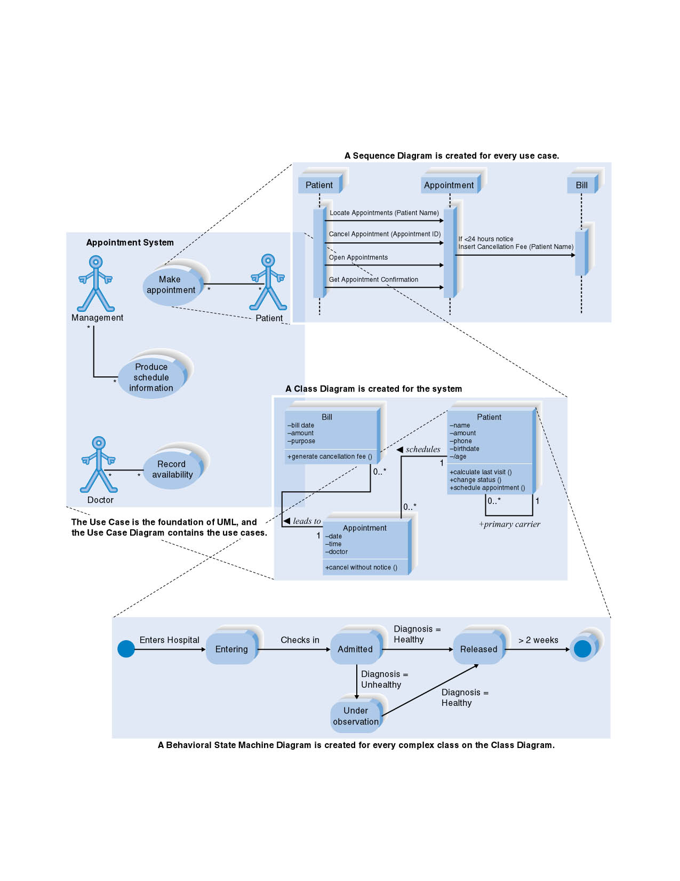
The Four Basic UML Diagrams

Slide 18
USE CASE DIAGRAM

Slide 19
Use Case Diagram Concepts
Summarizes all use cases (for the part of the system being modeled) together in one picture
Typically drawn early in the SDLC
Shows the associations between actors and use cases

Slide 20
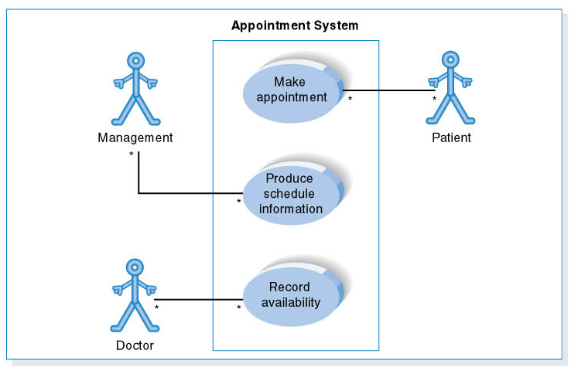
Use Case Diagram for Appointment System

Slide 21
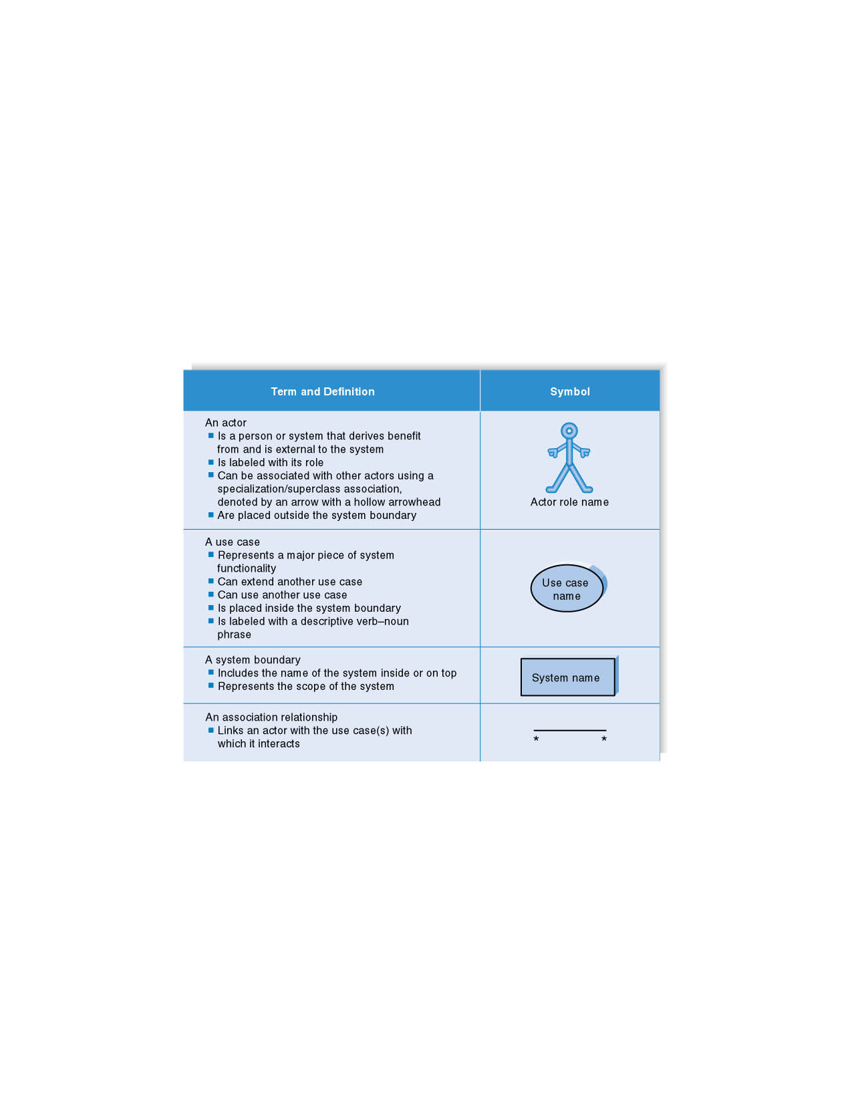
Syntax for Use Case Diagram

Slide 22
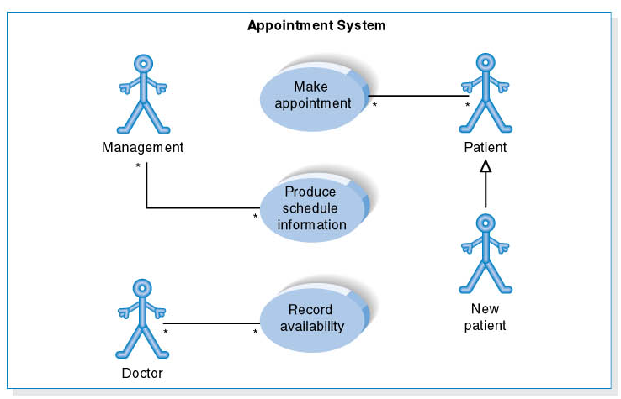
Use Case Diagram for Specialized Actor

Slide 23
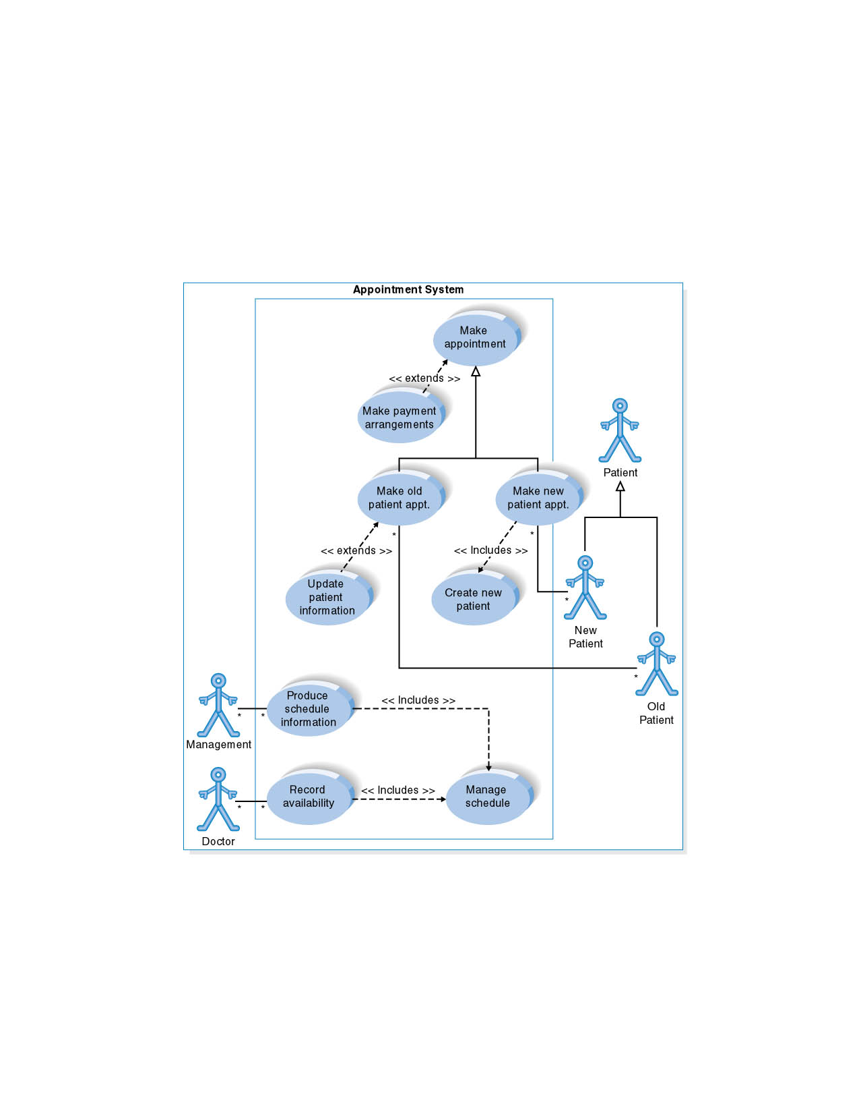
Extends and Includes Associations

Slide 24
Steps in Creating the Use Case Diagram
1. Identify Use Cases
2. Draw the system boundary
3. Place Use Cases on the diagram
Group Use Cases into packages
Add special Use Case associations
4. Identify the actors
5. Add associations

Slide 25
Exercise: Use Cases in UML
Choose at least 5 functional requirements for your team project. Draw a use case diagram similar to Fig. 6-9 on P. 181 that represents these requirements as use cases, along with the appropriate actors.

